Slide 1
Number Systems & Operations
Part I

Slide 2
Contents
Decimal Numbers
Binary Numbers
N-Based number to Decimal
Binary-to-Decimal Conversion
Decimal to N-Based Number
Decimal-to-Binary Conversion

Slide 3
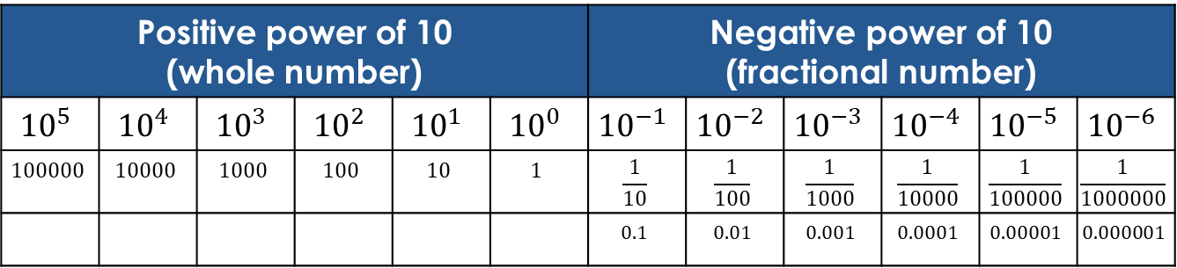
Decimal Numbers (Base 10)
Most commonly used number system
Only 10 digits (0-9) are used to form numbers
The value of a digit is determined by its position in the number and weighting structure of decimal numbers
The weighting structure of decimal numbers:
Positive power of 10 (whole number) |  |  |  |  |  | Negative power of 10 (fractional number)
$${10}^{5}$$ | $${10}^{4}$$ | $${10}^{3}$$ | $${10}^{2}$$ | $${10}^{1}$$ | $${10}^{0}$$ | $${10}^{−1}$$ | $${10}^{−2}$$ | $${10}^{−3}$$ | $${10}^{−4}$$ | $${10}^{−5}$$ | $${10}^{−6}$$
$$100000$$ | $$10000$$ | $$1000$$ | $$100$$ | $$10$$ | $$1$$ | $$\frac{1}{10}$$ | $$\frac{1}{100}$$ | $$\frac{1}{1000}$$ | $$\frac{1}{10000}$$ | $$\frac{1}{100000}$$ | $$\frac{1}{1000000}$$
 |  |  |  |  |  | $$0.1$$ | $$0.01$$ | $$0.001$$ | $$0.0001$$ | $$0.00001$$ | $$0.000001$$

Slide 4
Contents
Decimal Numbers
Binary Numbers
N-Based number to Decimal
Binary-to-Decimal Conversion
Decimal to N-Based Number
Decimal-to-Binary Conversion

Slide 5
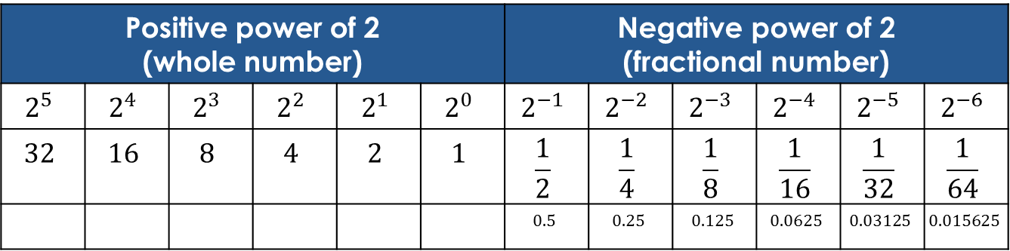
Binary Numbers (Base 2)
Only 2 digits (0 & 1) are used to form numbers
The value of a digit is determined by its position in the number and weighting structure of binary numbers
The weighting structure of binary numbers:
Positive power of 2 (whole number) |  |  |  |  |  | Negative power of 2 (fractional number)
$$2^{5}$$ | $$2^{4}$$ | $$2^{3}$$ | $$2^{2}$$ | $$2^{1}$$ | $$2^{0}$$ | $$2^{−1}$$ | $$2^{−2}$$ | $$2^{−3}$$ | $$2^{−4}$$ | $$2^{−5}$$ | $$2^{−6}$$
$$32$$ | $$16$$ | $$8$$ | $$4$$ | $$2$$ | $$1$$ | $$\frac{1}{2}$$ | $$\frac{1}{4}$$ | $$\frac{1}{8}$$ | $$\frac{1}{16}$$ | $$\frac{1}{32}$$ | $$\frac{1}{64}$$
 |  |  |  |  |  | $$0.5$$ | $$0.25$$ | $$0.125$$ | $$0.0625$$ | $$0.03125$$ | $$0.015625$$

Slide 6
Contents
Decimal Numbers
Binary Numbers
N-Based number to Decimal
Binary-to-Decimal Conversion
Decimal to N-Based Number
Decimal-to-Binary Conversion

Slide 7
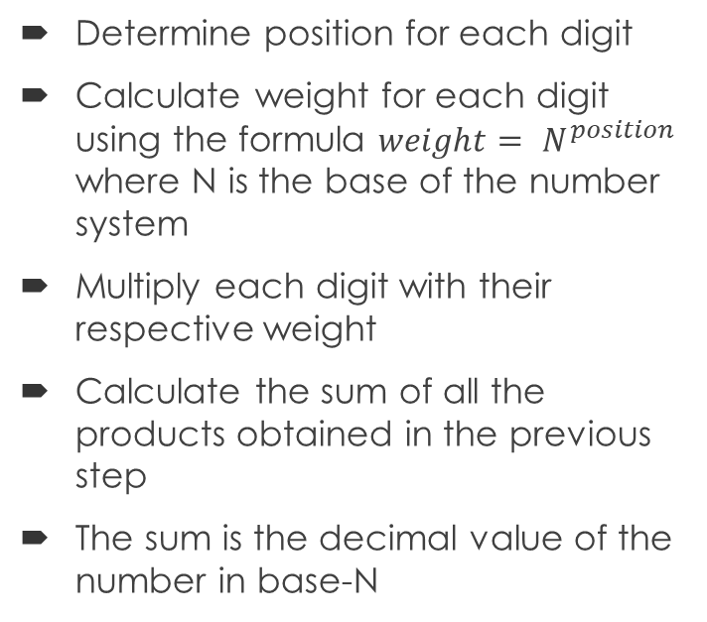
N-Based number to Decimal
Determine position
For the whole part, start from the rightmost digit before the ‘.’ and set its position to 0
Move from right to left and for each digit increment the position by 1
For the fractional part, start from the leftmost digit after the ‘.’ and set its position to -1
Move from left to right and for each digit decrement the position by 1
Determine position for each digit
Calculate weight for each digit using the formula $weight= N^{position}$ where N is the base of the number system
Multiply each digit with their respective weight
Calculate the sum of all the products obtained in the previous step
The sum is the decimal value of the number in base-N

Slide 8
Contents
Decimal Numbers
Binary Numbers
N-Based number to Decimal
Binary-to-Decimal Conversion
Decimal to N-Based Number
Decimal-to-Binary Conversion

Slide 9
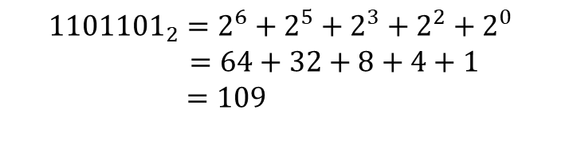

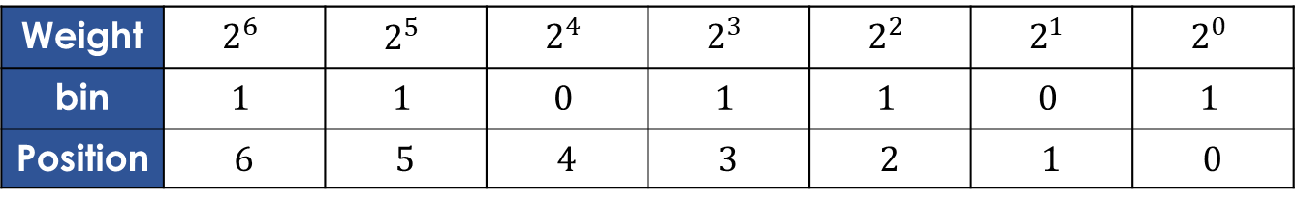
Whole Number
Add the weights of all 1s in a binary number to get the decimal value.
Example: convert ${1101101}_{2}$ to decimal
Weight | $$2^{6}$$ | $$2^{5}$$ | $$2^{4}$$ | $$2^{3}$$ | $$2^{2}$$ | $$2^{1}$$ | $$2^{0}$$
bin | $$1$$ | $$1$$ | $$0$$ | $$1$$ | $$1$$ | $$0$$ | $$1$$
Position | 6 | 5 | 4 | 3 | 2 | 1 | 0
$${1101101}_{2}=2^{6}+2^{5}+2^{3}+2^{2}+2^{0}$$
$=64+32+8+4+1$
$=109$

Slide 10
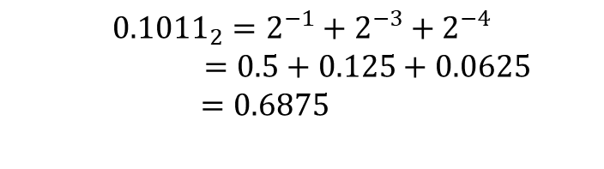

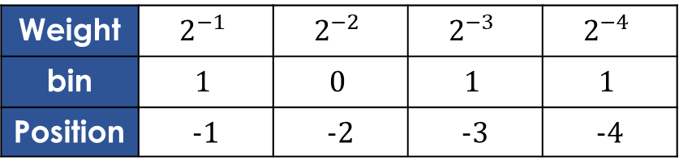
Fractional Number
Fractional binary example
Example: convert ${0.1011}_{2}$ to decimal
Weight | $$2^{−1}$$ | $$2^{−2}$$ | $$2^{−3}$$ | $$2^{−4}$$
bin | $$1$$ | $$0$$ | $$1$$ | $$1$$
Position | -1 | -2 | -3 | -4
$${0.1011}_{2}=2^{−1}+2^{−3}+2^{−4}$$
$=0.5+0.125+0.0625$
$=0.6875$

Slide 11
Contents
Decimal Numbers
Binary Numbers
N-Based number to Decimal
Binary-to-Decimal Conversion
Decimal to N-Based Number
Decimal-to-Binary Conversion

Slide 12

Whole Number
Repeated division-by-N method
To get the n-based number for a given decimal number, divide the decimal number by n until the whole part of quotient is $0$.
Remainders form the n-based number.

Slide 13


Fractional Number
Repeated multiplication by n
Decimal fraction can be converted to n-based by repeated multiplication by n
Example: convert ${0.3125}_{10}$ to binary
Continue till the desired number of decimal places or stop when the fractional part is all zero.
$${0.3125}_{10}={0.0101}_{2}$$

Slide 14
Contents
Decimal Numbers
Binary Numbers
N-Based number to Decimal
Binary-to-Decimal Conversion
Decimal to N-Based Number
Decimal-to-Binary Conversion

Slide 15
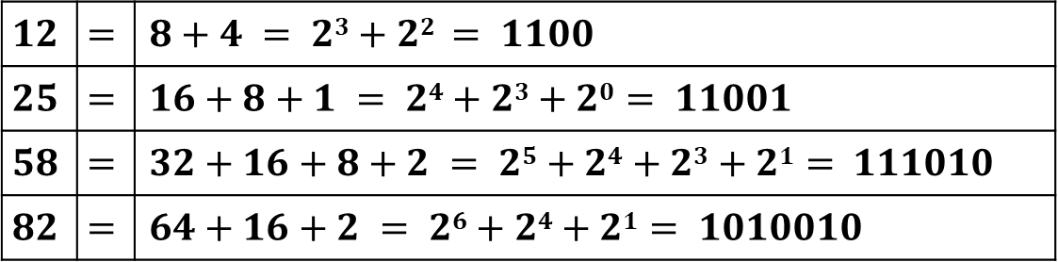

Whole Number
Sum-of-weights method
To get the binary number for a given decimal number, find the binary weights that add up to the decimal number.
Example: convert ${12}_{10}$, ${25}_{10}$, ${58}_{10}$, ${82}_{10}$ to binary
$$12$$ | $$=$$ | $$8+4 = 23+22 = 1100$$
$$25$$ | $$=$$ | $$16+8+1 = 24+23+20 = 11001$$
$$58$$ | $$=$$ | $$32+16+8+2 = 25+24+23+21 = 111010$$
$$82$$ | $$=$$ | $$64+16+2 = 26+24+21 = 1010010$$

Slide 16

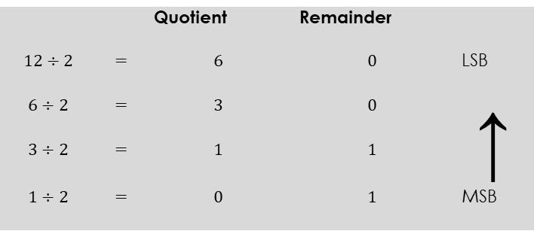


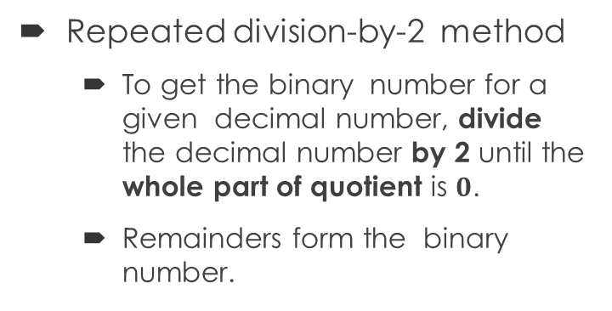
Whole Number
Repeated division-by-2 method
To get the binary number for a given decimal number, divide the decimal number by 2 until the whole part of quotient is $0$.
Remainders form the binary number.
 |  | Quotient | Remainder
$$12÷2$$ | $$=$$ | $$6$$ | $$0$$ | LSB
$$6÷2$$ | $$=$$ | $$3$$ | $$0$$ | ↑
$$3÷2$$ | $$=$$ | $$1$$ | $$1$$
$$1÷2$$ | $$=$$ | $$0$$ | $$1$$ | MSB
Stop when the whole part of quotient is $0$
$${12}_{10}={1100}_{2}$$

Slide 17

Fractional Number
Converting decimal fractions to binary
Sum-of-weights method
This method can be applied to fractional decimal numbers, as shown in the following example:
$0.625=0.5+0.125 =2^{−1}+2^{−3}= 0.101$

Slide 18
Fractional Number
Repeated multiplication by 2
Decimal fraction can be converted to binary by repeated multiplication by 2
Example: convert ${0.3125}_{10}$ to binary
Continue till the desired number of decimal places or stop when the fractional part is all zero.
$${0.3125}_{10}={0.0101}_{2}$$

Slide 19
End of Part I

